Slide 1
RESOLUCION DEL EXAMEN HITO2
Estudiante : Sarai Leslie Alvarez Rosas

Slide 2
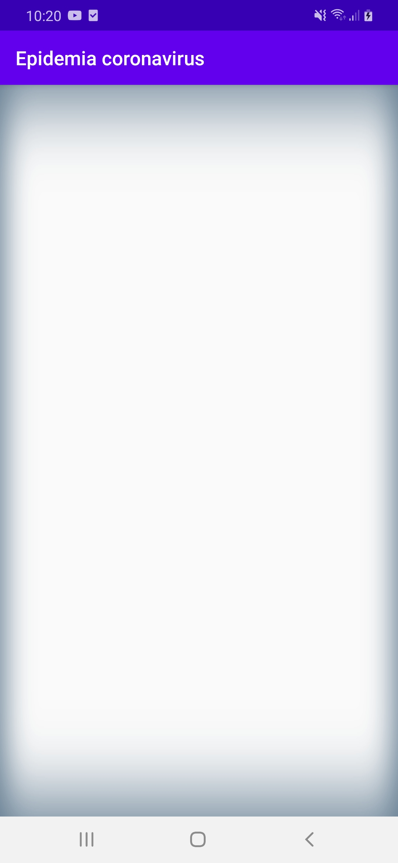
DISEÑO
activity_main.xml
paso1.-
<?xml version="1.0" encoding="utf-8"?> <LinearLayout xmlns:android="http://schemas.android.com/apk/res/android" xmlns:tools="http://schemas.android.com/tools" xmlns:app="http://schemas.android.com/apk/res-auto" android:layout_width="match_parent" android:layout_height="match_parent" android:orientation="vertical" android:background="@drawable/fondo" tools:context=".MainActivity"> <LinearLayout android:layout_width="match_parent" android:layout_height="wrap_content" android:orientation="vertical" android:gravity="center" android:padding="40dp"> </LinearLayout> </LinearLayout>

Slide 3
DISEÑO
activity_main.xml
paso2.-poner LinearLayout
<?xml version="1.0" encoding="utf-8"?> <LinearLayout xmlns:android="http://schemas.android.com/apk/res/android" xmlns:tools="http://schemas.android.com/tools" xmlns:app="http://schemas.android.com/apk/res-auto" android:layout_width="match_parent" android:layout_height="match_parent" android:orientation="vertical" android:background="@drawable/fondo" tools:context=".MainActivity"> <LinearLayout android:layout_width="match_parent" android:layout_height="wrap_content" android:orientation="vertical" android:gravity="center" android:padding="40dp">
<LinearLayout…>//imagen
<LinearLayout…>//ciudad cochabamba
<LinearLayout…>//ciudad santa cruz
<LinearLayout…>//ciudad oruro
<LinearLayout…>//setvalues
<LinearLayout…>//botón calcular </LinearLayout> </LinearLayout>

Slide 4
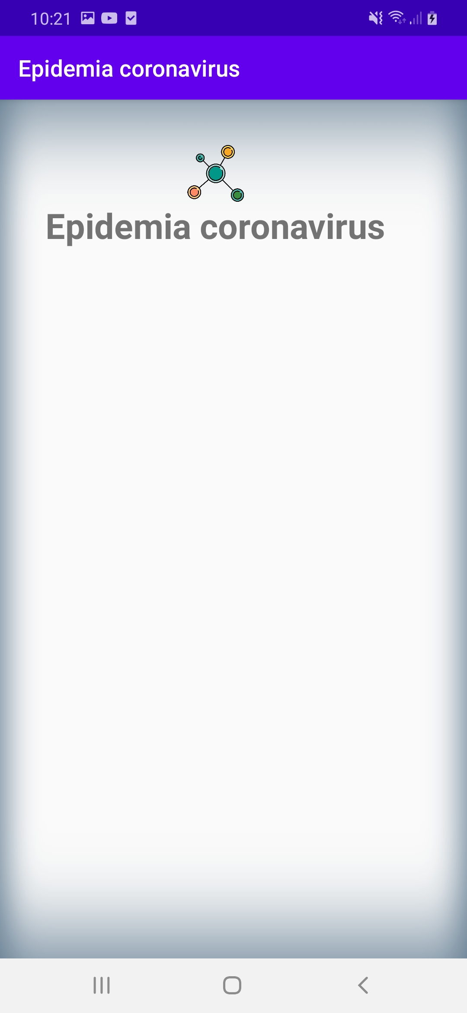
activity_main.xml
Paso 3.- desarrollar <LinearLayout…>//imagen
<LinearLayout android:layout_width="match_parent" android:layout_height="wrap_content" android:orientation="vertical"> <ImageView android:layout_width="300dp" android:layout_height="50dp" android:src="@drawable/virus"></ImageView> <TextView android:layout_width="wrap_content" android:layout_height="wrap_content" android:text="@string/app_name" android:textSize="28sp" android:textStyle="bold"></TextView> </LinearLayout>//imagen

Slide 5
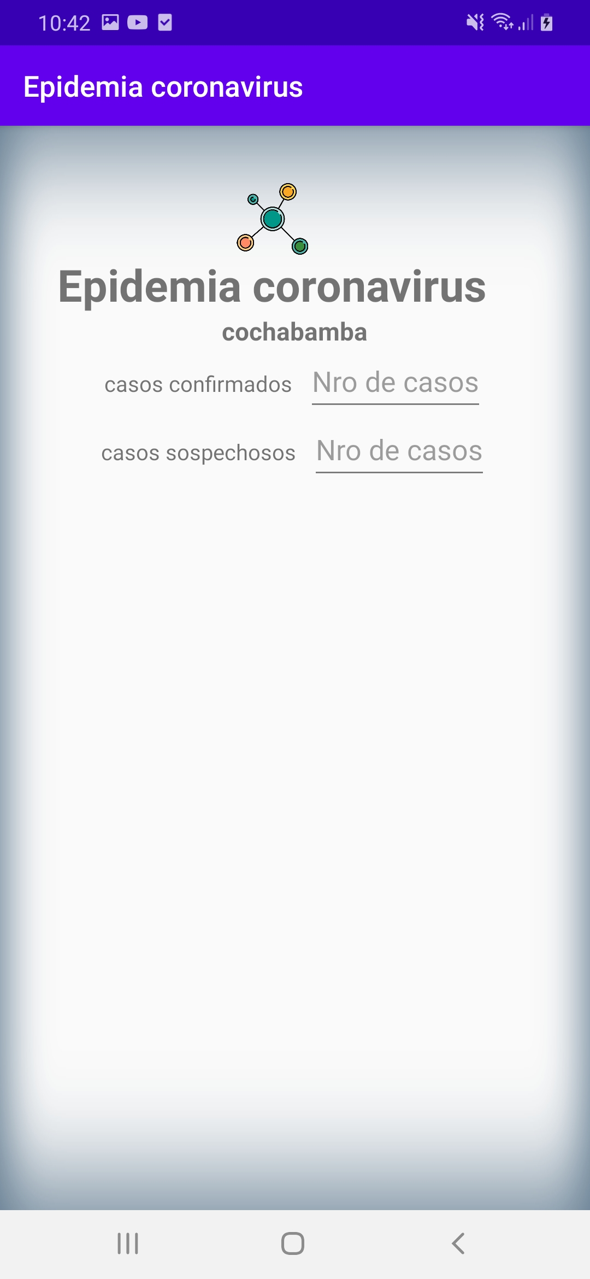
activity_main.xml
Paso 4.- desarrollar <LinearLayout…>//ciudad cochabamba
<LinearLayout android:orientation="vertical" android:gravity="center" android:layout_width="wrap_content" android:layout_height="wrap_content"> <TextView android:text="@string/cochabamba" android:textSize="16sp" android:textStyle="bold" android:layout_width="wrap_content" android:layout_height="wrap_content"> </TextView> <LinearLayout android:orientation="horizontal" android:layout_gravity="center" android:layout_width="wrap_content" android:layout_height="wrap_content"> <TextView android:text="@string/confirmados" android:layout_width="wrap_content" android:layout_marginEnd="10dp" android:layout_height="wrap_content"> </TextView> <EditText android:id="@+id/confCb" android:hint="@string/placeholder" android:layout_width="wrap_content" android:layout_height="wrap_content"> </EditText> </LinearLayout>
<LinearLayout android:orientation="horizontal" android:layout_gravity="center" android:layout_width="wrap_content" android:layout_height="wrap_content"> <TextView android:text="@string/sospechosos" android:layout_width="wrap_content" android:layout_marginEnd="10dp" android:layout_height="wrap_content"> </TextView> <EditText android:id="@+id/sospCb" android:hint="@string/placeholder" android:layout_width="wrap_content" android:layout_height="wrap_content"> </EditText> </LinearLayout> </LinearLayout>//ciudad

Slide 6
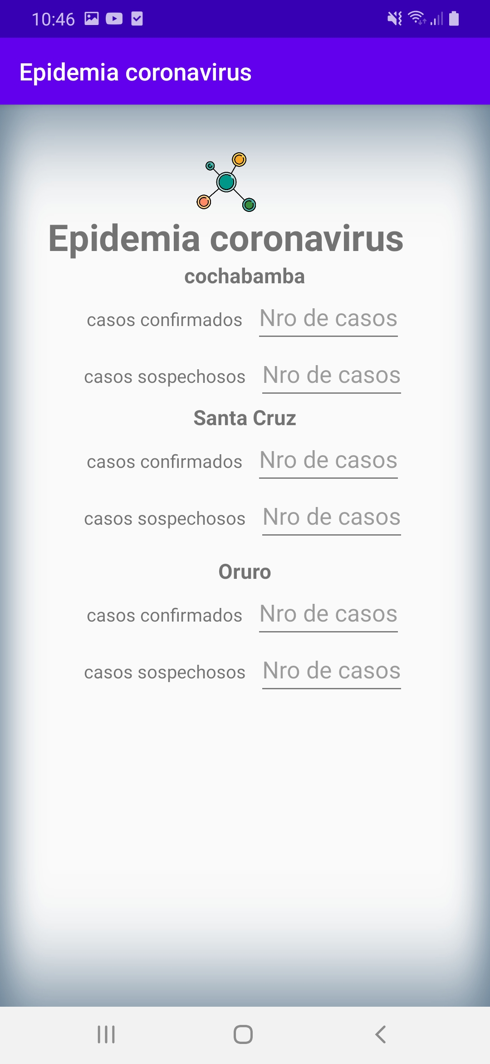
activity_main.xml
Paso 5.- copiar y pegar el codigo de
<LinearLayout…>//ciudad cochabamba
Para <LinearLayout…>//ciudad santa cruz
y <LinearLayout…>//ciudad Oruro
y cambiar valores

Slide 7
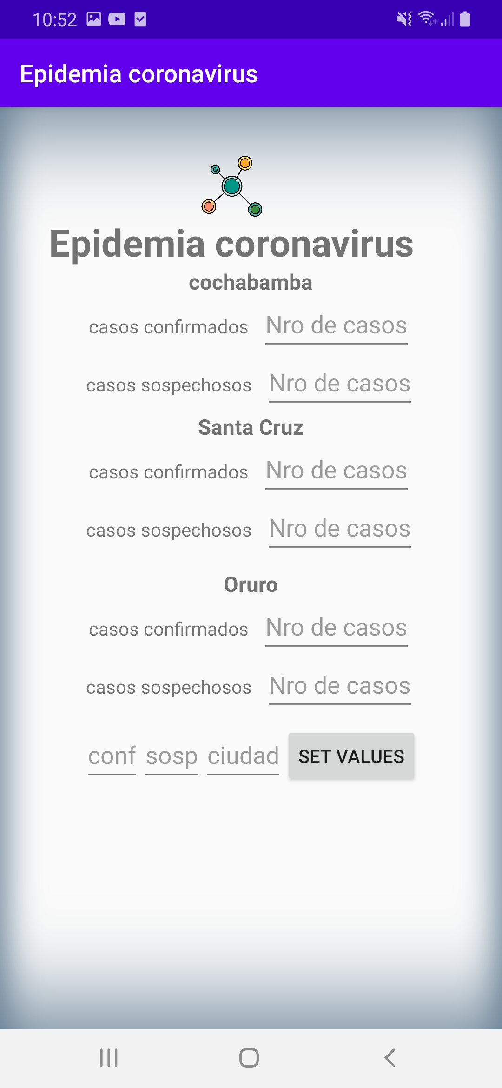
activity_main.xml
Paso 6.- desarrollar <LinearLayout…>//setvalues
<LinearLayout android:orientation="vertical" android:gravity="center" android:layout_width="wrap_content" android:layout_height="wrap_content"> <LinearLayout android:orientation="horizontal" android:gravity="center" android:layout_marginTop="10dp" android:layout_width="wrap_content" android:layout_height="wrap_content" > <EditText android:id="@+id/confirmados" android:hint="@string/conf" android:layout_width="wrap_content" android:layout_height="wrap_content"> </EditText> <EditText android:id="@+id/sospechosos" android:hint="@string/cs" android:layout_width="wrap_content" android:layout_height="wrap_content"> </EditText>
<EditText android:id="@+id/etciudad" android:hint="@string/ciudad" android:layout_width="wrap_content" android:layout_height="wrap_content"> </EditText> <Button android:id="@+id/setvalues" android:text="@string/setValues" android:layout_width="wrap_content" android:layout_height="wrap_content"> </Button> </LinearLayout> </LinearLayout>//setvalues

Slide 8
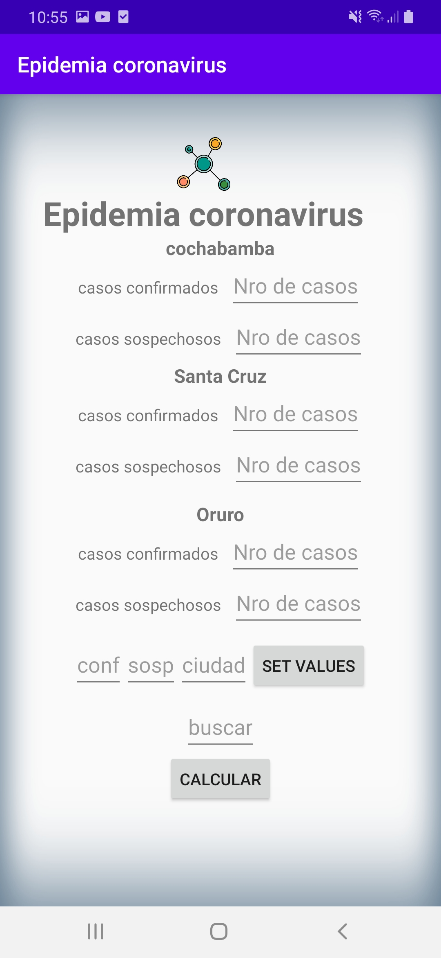
activity_main.xml
Paso 7.- desarrollar <LinearLayout…>//botón calcular
<LinearLayout android:orientation="vertical" android:gravity="center" android:layout_marginTop="10dp" android:layout_width="wrap_content" android:layout_height="wrap_content"> <EditText android:id="@+id/etbuscar" android:hint="@string/busqueda" android:layout_width="wrap_content" android:layout_height="wrap_content"> </EditText> <Button android:id="@+id/btcalcular" android:text="@string/calcular" android:layout_width="wrap_content" android:layout_height="wrap_content"> </Button> </LinearLayout>//botón calcular

Slide 9
strings.xml
<resources> <string name="app_name">Epidemia coronavirus</string> <string name="cochabamba">cochabamba</string> <string name="santacruz">Santa Cruz</string> <string name="oruro">Oruro</string> <string name="confirmados">casos confirmados</string> <string name="sospechosos">casos sospechosos</string> <string name="placeholder">Nro de casos</string> <string name="conf">conf</string> <string name="cs">sosp</string> <string name="ciudad">ciudad</string> <string name="setValues">set values</string> <string name="busqueda">buscar</string> <string name="calcular">calcular</string> </resources>

Slide 10
CODIGO
MainActivity.java
Paso 8: Importar librerias y definer variables
import androidx.appcompat.app.AppCompatActivity; import android.os.Bundle; import android.view.View; import android.widget.Button; import android.widget.EditText; import android.widget.Toast; public class MainActivity extends AppCompatActivity { private EditText conf, sosp, etciudad, buscar, confCb, confSc, confOr, sospCb, sospSc, sospOr; private Button setvalues, calcular; private String sconf,ssosp,ciudad; @Override protected void onCreate(Bundle savedInstanceState) { super.onCreate(savedInstanceState); setContentView(R.layout.activity_main);
initializeVariables(); } }

Slide 11
MainActivity.java
Paso 9: dezarrollar initializeVariables();
public void initializeVariables() { confCb = findViewById(R.id.confCb); confSc = findViewById(R.id.confSc); confOr = findViewById(R.id.confOr); sospCb = findViewById(R.id.sospCb); sospSc = findViewById(R.id.sospSc); sospOr = findViewById(R.id.sospOr); conf = findViewById(R.id.confirmados); sosp = findViewById(R.id.sospechosos); etciudad = findViewById(R.id.etciudad); buscar = findViewById(R.id.etbuscar); setvalues = findViewById(R.id.setvalues); setvalues.setOnClickListener(this); calcular = findViewById(R.id.btcalcular); calcular.setOnClickListener(this); }

Slide 12
MainActivity.java
Paso 10: implementar implements View.OnClickListener
public class MainActivity extends AppCompatActivity implements View.OnClickListener { private EditText conf, sosp, etciudad, buscar, confCb, confSc, confOr, sospCb, sospSc, sospOr; private Button setvalues, calcular; private String sconf,ssosp,ciudad; @Override protected void onCreate(Bundle savedInstanceState) {…} public void initializeVariables() {…} @Override public void onClick(View v) {…} public void llevar(){…} public void calcular(){…}
}

Slide 13
MainActivity.java
Paso 11:desarrollar public void onClick(View v) {…}
@Override public void onClick(View v) { switch (v.getId()) { case R.id.setvalues: llevar(); break; case R.id.btcalcular: calcular(); break; } }

Slide 14
MainActivity.java
Paso 12:desarrollar public void llevar(){…}
public void llevar() { sconf=conf.getText().toString(); ssosp=sosp.getText().toString(); ciudad=etciudad.getText().toString(); if(ciudad.equals("cbba")) { confCb.setText(sconf); sospCb.setText(ssosp); } if(ciudad.equals("sc")) { confSc.setText(sconf); sospSc.setText(ssosp); } if(ciudad.equals("or")) { confOr.setText(sconf); sospOr.setText(ssosp); } }

Slide 15
MainActivity.java
Paso 13:desarrollar public void calcular(){…}
if(buscar.getText().toString().equals("confir")) { if(v1<v2) { if(v2<v3) {Toast.makeText(getApplication(),"los confirmados son "+v3,Toast.LENGTH_SHORT ).show();} else {Toast.makeText(getApplication(),"los confirmados son "+v2,Toast.LENGTH_SHORT ).show();} } else if(v1>v2) { if(v1<v3) { Toast.makeText(getApplication(),"los confirmados son "+v3,Toast.LENGTH_SHORT ).show();} else {Toast.makeText(getApplication(),"los confirmados son "+v1,Toast.LENGTH_SHORT ).show();} }}}
public void calcular() { int v1 = Integer.parseInt(confCb.getText().toString()); int v2 = Integer.parseInt(confSc.getText().toString()); int v3 = Integer.parseInt(confOr.getText().toString()); int v4 = Integer.parseInt(sospCb.getText().toString()); int v5 = Integer.parseInt(sospSc.getText().toString()); int v6 = Integer.parseInt(sospOr.getText().toString());
if(buscar.getText().toString().equals("sospe")) { if(v4<v5) { if(v5<v6) {Toast.makeText(getApplication(),"los confirmados son "+v4,Toast.LENGTH_SHORT ).show();} else {Toast.makeText(getApplication(),"los confirmados son "+v5,Toast.LENGTH_SHORT ).show();} } else if(v4>v5) { if(v4<v6) {Toast.makeText(getApplication(),"los confirmados son "+v6,Toast.LENGTH_SHORT ).show();} else {Toast.makeText(getApplication(),"los confirmados son "+v4,Toast.LENGTH_SHORT ).show();} } }

Slide 16
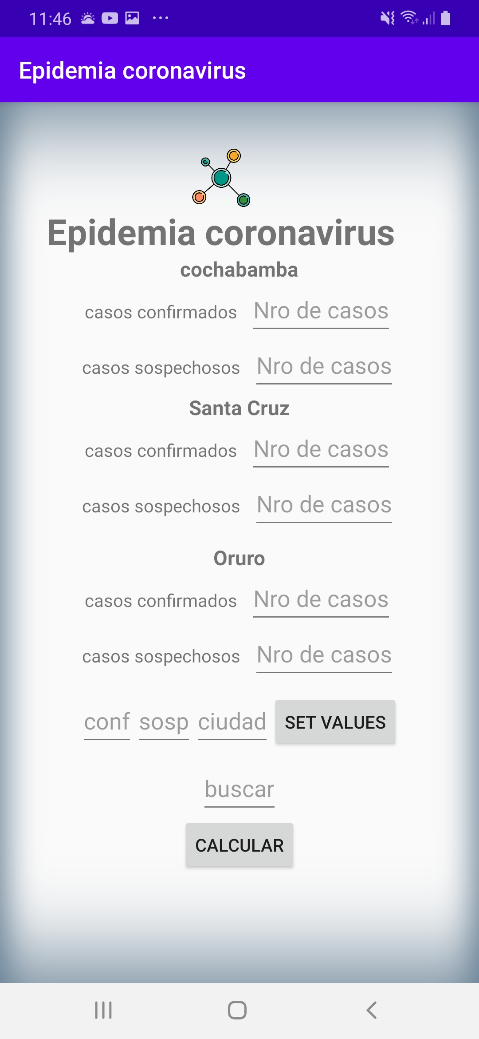
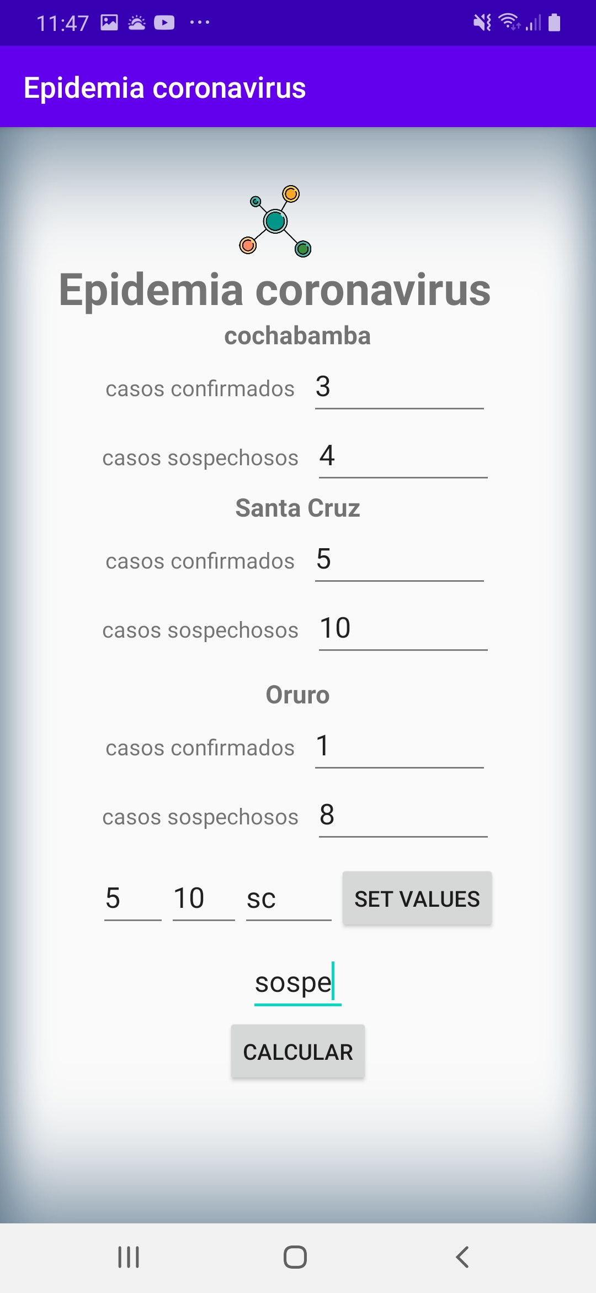
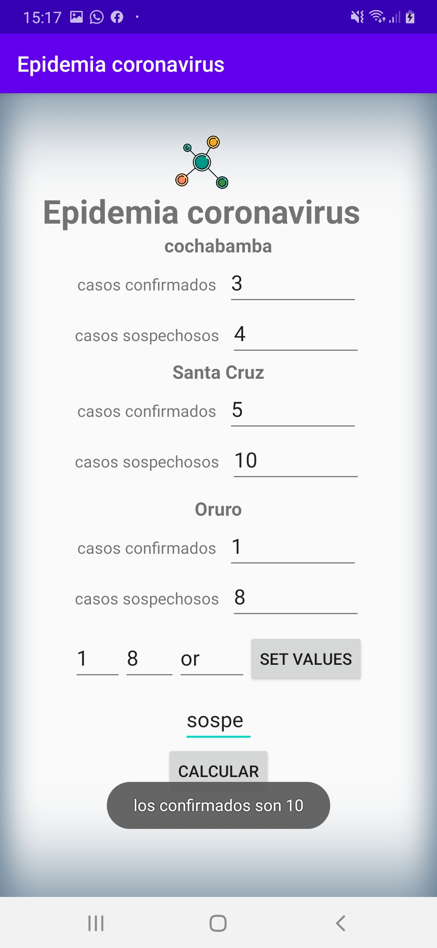
FUNCIONALIDAD

